Slide 1
Box Office Movie Performance

Slide 2
Objectives
Does “Social Buzz” lead to High title sales?
When should I create a Social buzz to increase title sales?
What Genre/Titles sales are most effected by “Social buzz”?
Notes:
This Presentation aims to answer the following questions- " Do social media buzz lead to high sales?"
When is the best time to create social media buzz to increase sales?

Slide 3
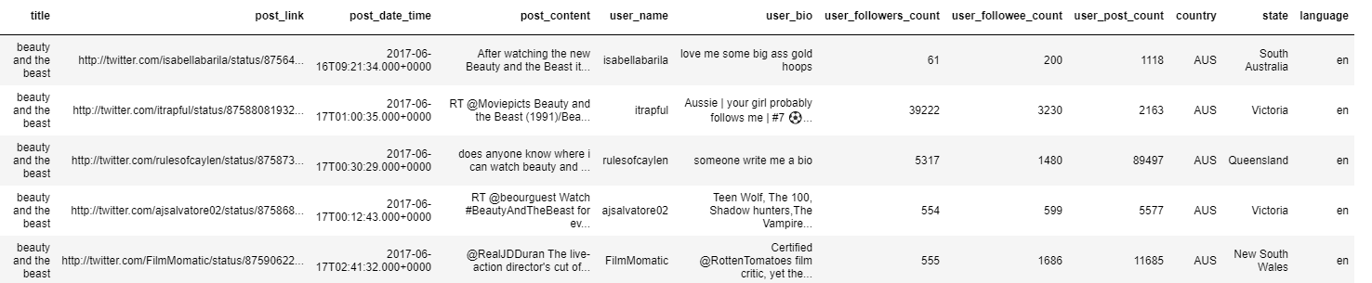
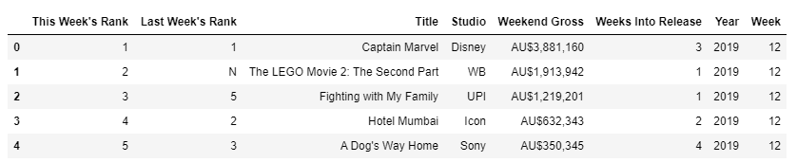
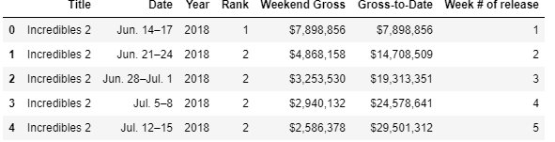
Datasets
Twitter data : 25 titles in 2017, 2018 and 2019
Recruitment data: 1099 titles in 2017, 2018 and 2019
Titles data: 19 titles in 2017, 2018 and 2019
Notes:
3 Datasets used -
Twitter Data: consists of posts, twitter handles,
twitter follower count, twitter followee count
Recruitment Data: consists of 1099 titles in 2017, 2018 and 2018 and thier weekend_gross and gross_to_date
Titles Data: 19 titles in 2017, 2018 and 2019

Slide 4
Methodology
Use NLP techniques to “Social Buzz” features from twitter data
Identify time series patterns in movie lifecycle. How are do movie sales vary with age (# weeks from release)
Identify time series patterns in “Social Buzz” lifecycle. How does social buzz around a movie change with movie age?
Notes:
1) Create "social buzz" features from twitter data.
2) Identify timeseries patterns in movie sales
3) Identify timeseries patterns in Social buzz

Slide 5
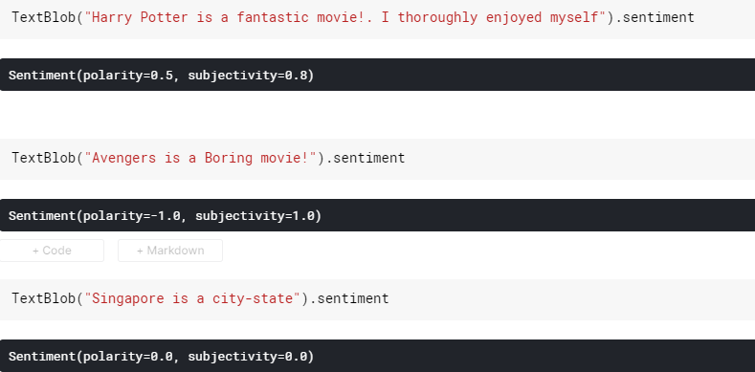
Convert Twitter Posts to Sentiments
A sentiment score for twitter posts is generated using the library “TextBlob”, which is built on nltk
Uses the Naïve Bayes classifier to assign sentiment scores to text data
Polarity: Indicative of sentiment. takes a value between 1 (positive) and – 1 (negative)
Subjectivity: Is this a fact or opinion? (0: fact , 1:opinion)
Notes:
In statement 1" Harry Potter is a Fantastic movie. I thoroughly enjoyed myself". This has been classified as a
positive statement (polarity = 0.5) and as an opinion
Second statement is classified as a negative opinion
The third statement is classified as a neutral fact.

Slide 6
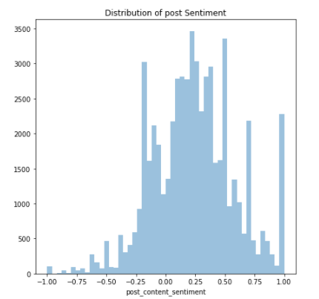
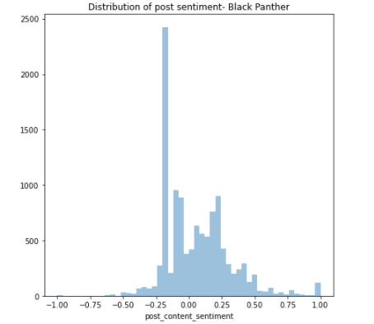
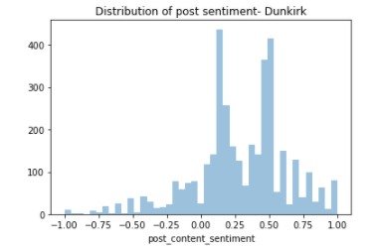
Distributions of Post – Sentiment (Polarity)
Sentiment scores of 0 have been removed
Notes:
The overall distribution and the distribution of post polarity for individual movies follows a normal-like distribution

Slide 7
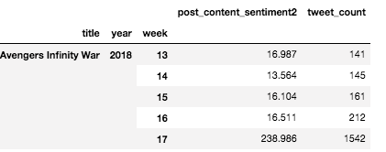

“Social Buzz” Features
sum of Sentiment² = $Σ{sentiment}^{2}$
within every title-year-week group
Log_sentiment = log(Sum of Sentiment² )
Tweet count = number of tweets within every title- year-week group
Notes:
The Sentiment features for a title are aggregated for every title-year-week
Sentiment^2 is aggregated so that positive and negative posts dont cancel out.
Tweet count: Number of tweets in a title-year-week

Slide 8
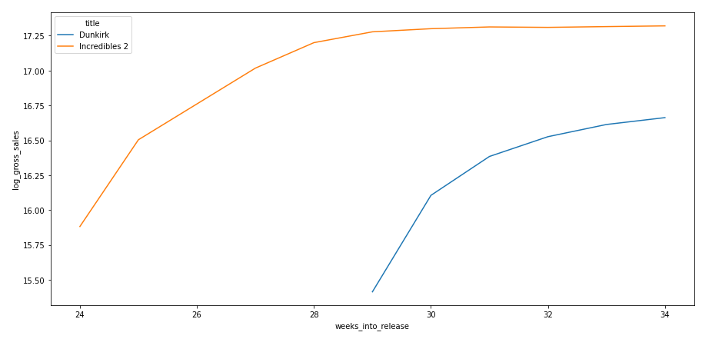
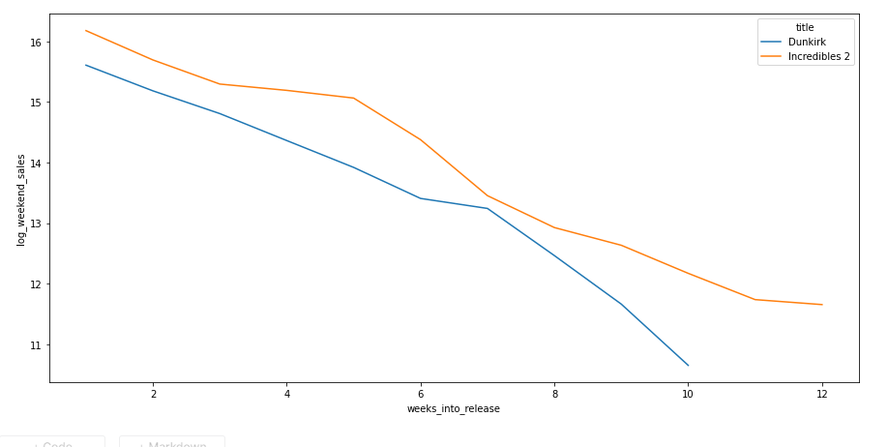
Temporal behavior of gross sales and weekend sales
Weekend Sales diminish with time. (Law of diminishing returns!!)
Notes:
Temporal behavior of gross_sales and weekend_sales shows diminishing returns
There is a linear relationship between log(weekend_sales) ~ weeks_into_release

Slide 9
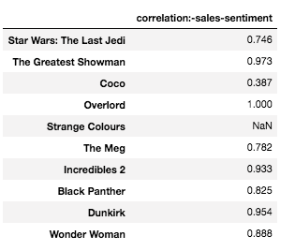
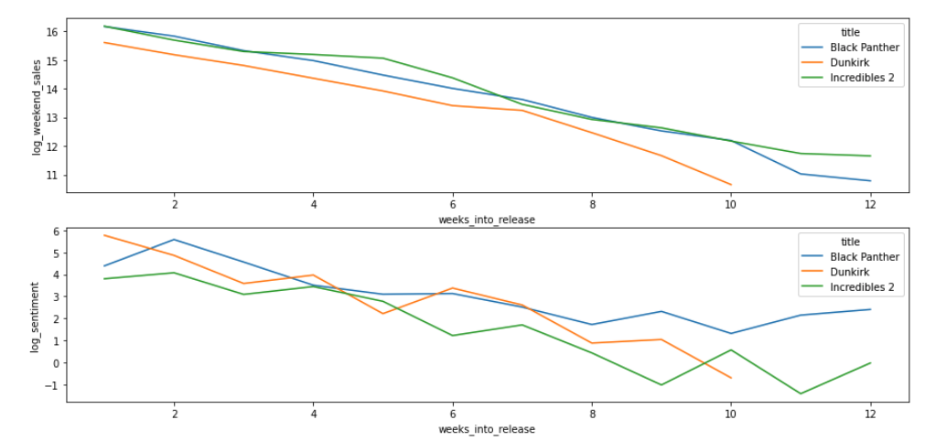
Temporal behaviour of log_weekend_sales, log_sentiment
The variables log_weekend_sales and log_sentiment look highly correlated.
Notes:
Strange Colours has only 1 datapoint and overlord has 2 datapoints/
Both log_sentiment and log_weekend_sales show a timeseries behaviour

Slide 10
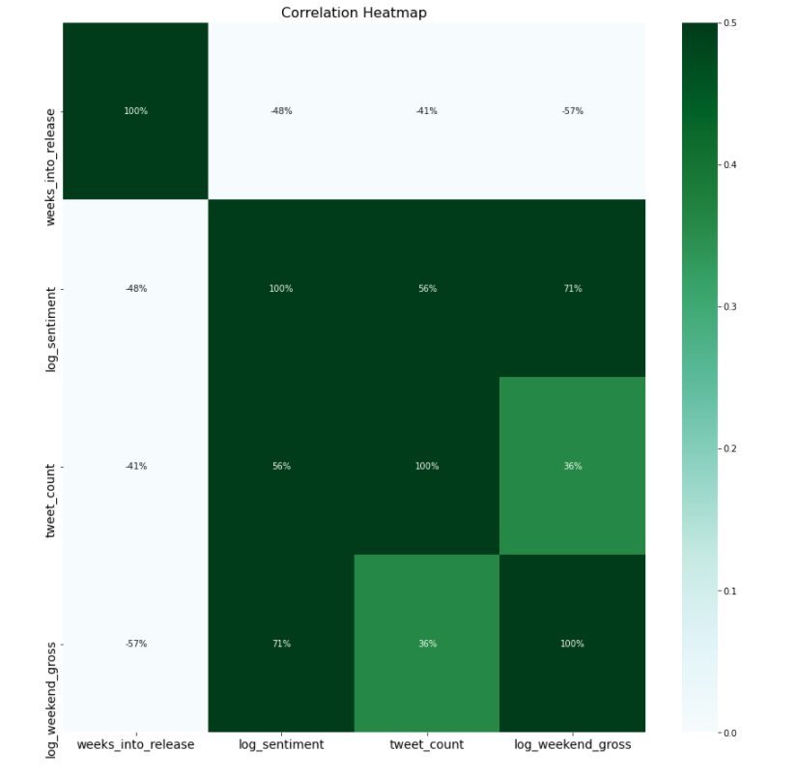
Correlation Heatmap for weekend sales
A correlation heatmap is for log_weekend_sales
Weeks_into_release:- strong negative correlation with
log_weekend_sales/log_weekend_gross (-57%) and log_sentiment (-48%)
Social Buzz Variables:
Tweet_count: Strong correlation with log_weekend_sales
Log_sentiment: Strong correlation with
log_weekend_sales and tweet_count
Notes:
Strong negative correlation between log_weekend_sales and ad weeks_Into_release

Slide 11
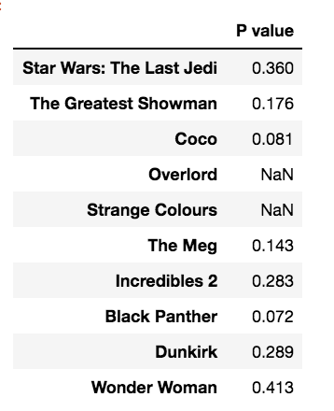
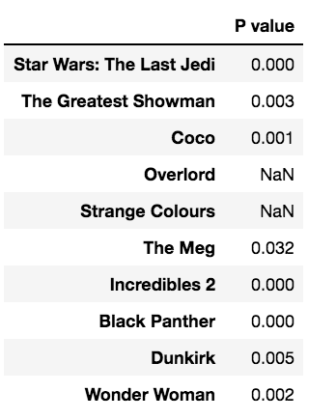
Perform Linear Regression to check significance of predictors
Log(weekend_sales) ~ weeks_into_release + log(sentiment)
Log(Sentiment)
Weeks into release
Inspite of the high correlation, pvalues for log(sentiment) vs log(weekend_gross) are not significant. Pvalue for
Weeks into release is significant for all titles
Notes:
Overlord: 2 datapoints
Strange Colours : 1 datapoint
The p values show that for every movie, the relationship between weekend_sales and sentiment is not significanyt
In contrast, the relationship between weeken_sales and weeks into release is significant

Slide 12
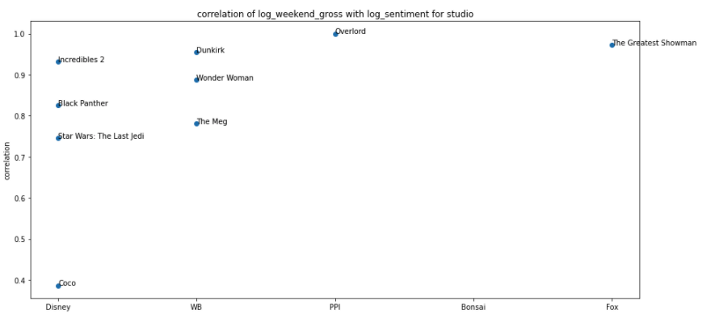
Does correlation of log_weekend_sales with log_sentiment depend on Studio?
Correlation of log(weekly_sales) ~ log(sentiment) vs Studio
No correlation seen with Studio. Fantasy movies coco, Incredibles2 and Star Wars have very different correlations!
Notes:
The correlation between sentiment and weekly sales vary across studio

Slide 13
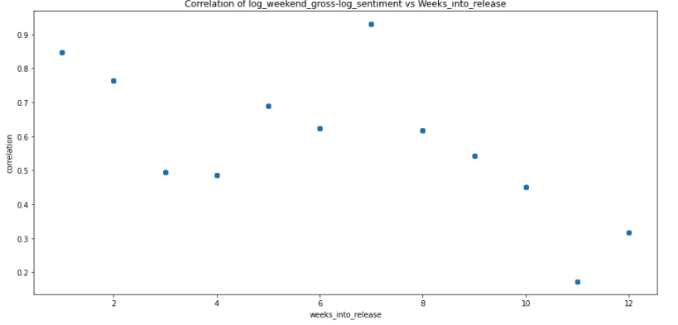
Does correlation of weekend sales with sentiment depend on week into release?
Correlation vs week
A Strong positive correlation between log_weekend_sales and log_sentiment for every week_of_release
Titles that have high sales every week have a high social media buzz
Notes:
The correlation values for weeks 11, 12 and 13 are not reliable due to fewer datapoints.

Slide 14
Conclusion
Weekend Sales for movies follow a life-cycle. This life-cycle behavior is the biggest predictor of sales.
Social buzz follows a similar lifecycle
Creating a Social buzz may improve the sales-performance within the life – cycle behavior
Notes:
who posts,
do people engage in conversations? how is the engagement?
follower-following rations ( media accounts/ professional bloggers)
limitation- constrainsts, life cycle for individual movie

